Slide 1

International Conference & Workshop on Emerging Trends in Technology 2010

Slide 2

PAPER ID: 45 IMPLEMENTATION OF SMART IRRIGATION SYSTEM USING SOIL MOISTURE SENSOR. Ms. Ugandhara Gaikwad Shubhamkumar Pathak Sarvesh Pandey Rohan Mishra Roshan Prajapati

Slide 3
PRESENTATION FLOW
Abstract
Problem Definition
Introduction
Theory
Important Findings
Results and Discussions
Conclusion
Acknowledgement
References

Slide 4
ABSTRACT
India is a country with Agriculture as the major profession. More than half the population of India (72%approx) is engaged in primary activities like agriculture. Due to the population growth, the demand for food and water is Tremendously increasing. Thus, in the agriculture sector, the main challenge faced by the farmer is the optimization of water. There is a need to set up a system that keeps track of the utilization of water in the field. The only advocacy solution is improvement in irrigation techniques. The smart irrigation system using soil moisture sensors is an idea proposed by us to reduce the excessive use of water and provide proper yielding to the crops we are using the " Extra sunshine hour” module the practitioner can attain the desired quality of yield irrespective of any climatic condition.

Slide 5
PROBLEM DEFINITION
Until quite recently, India enjoyed abundant water resources. But population growth and overexploitation have led to a situation where the water demand is exceeding the supply.
During manual irrigation, the water necessity of plants/crops is not monitored. Even when the soil is moist sufficient, water is yet provided.
This water is not absorbed by the plant and thus is lost. Hence, a system is to monitor the plant's water requirements is needed.

Slide 6
INTRODUCTION
Key Definition: Soil moisture sensor, extra sunshine hours, desire yielding, grow lights.
INTRODUCTION:
As we know the greatest problems faced by the world is water shortage and agriculture being demanding occupation consumes plenty of water.
In the traditional irrigation method, the requirements of water for crops are not
monitored by the framer. Even when the soil contains enough moisture, water is still provided/supplied.
This water is not absorbed by the plants and thus it is wasted.
Therefore, we have developed a smart irrigation system using a soil moisture sensor that measures moisture at the root zone and optimizes the use of water.
To enhance landscape health and gain optimistic yield we used the "Extra sunshine Hour" method.

Slide 7
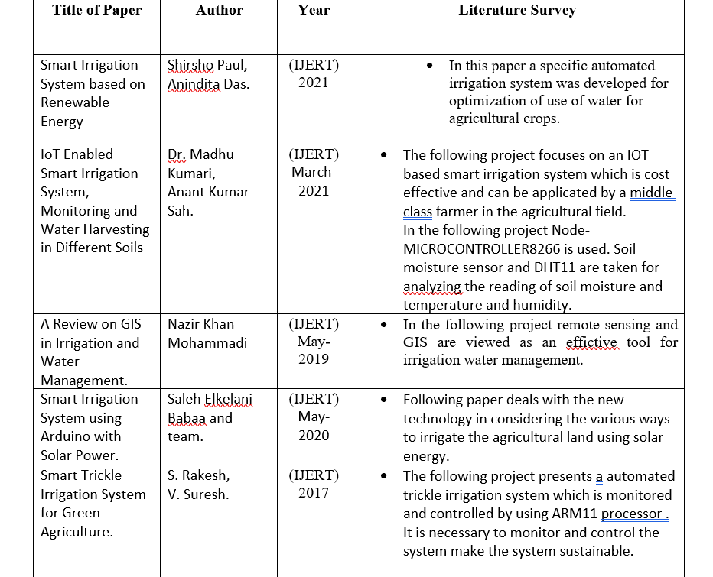
INTRODUCTION
LITERATURE SURVEY:
A lot of work has been done and is currently going on this topic. Various researchers had derived different ideas on this topic. A low-cost smart irrigation system is proposed by seeking today's demand. Here are some literature reviews on the past research related to the topic.

Slide 8
THEORY
PROPOSED METHODOLOGY:
Our proposed methodology is that we are going to prepare a smart irrigation system Arduino based soil moisture sensor.
The following components are to be purchased by the Wholesalers: Arduino uno (with USB), four relay board, soil sensor (probe), jumper wires (m/f) and jumper wires (f/f).
The working of our proposed smart irrigation model:
The field study generally includes the process of implementation of our model into the agriculture field. Which will work in the following ways.
Our system which is generally dealing with soil moisture & temperature sensor will provide certain data.
On analyzing that our system used to turn the values ON or OFF automatically as per the water requirement of plants.
The system is used for sensing monitoring, controlling and for communication purpose.
Depending upon the sensor output the processor will take the necessary action.

Slide 9
THEORY
Extra sunshine Hour:
By observing the current need in the agricultural sector for vegetating the desired yield we have developed a component named "Extra Sunshine Hour".
The "Extra sunshine Hour" module uses a certain hue of light for the nourishment of crops as per the practitioner's necessity. This Extra Sunshine Hour " module helps to achieve the desired quality of yield.
We have used two different spectrums of light i.e., Red and blue which is the crucial spectrum used by the plants for photosynthesis to transform water, sunlight, and carbon dioxide into oxygen, and simple sugars that the crop uses as fuel.
We can control these lights with the help of an application that operates the Arduino.

Slide 10
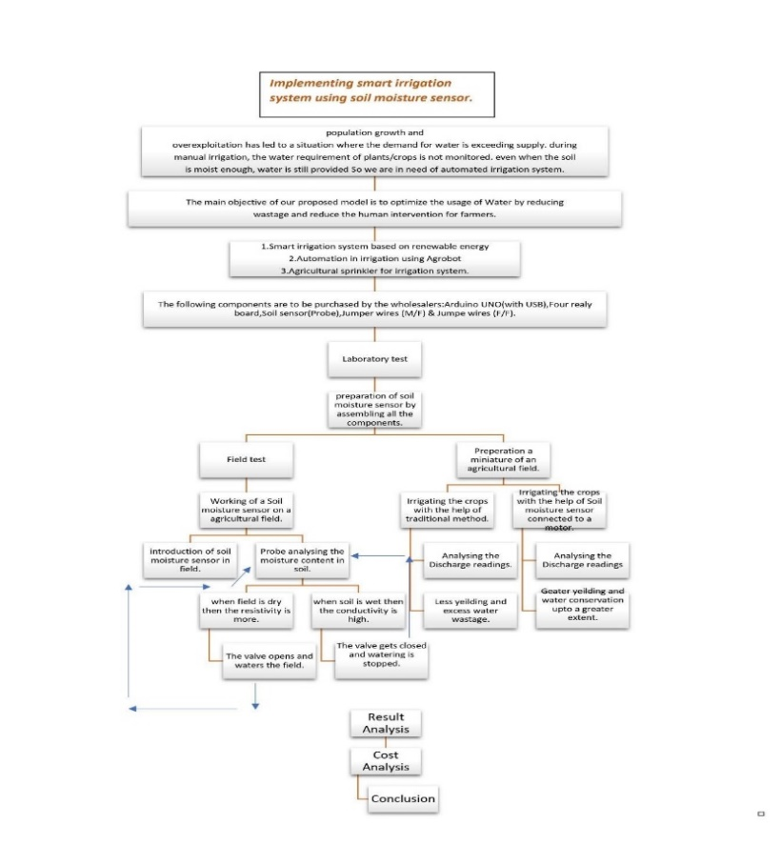
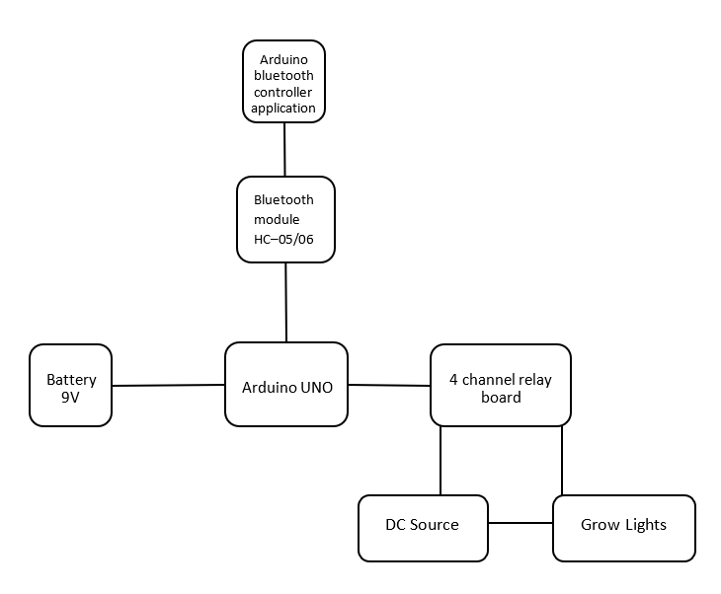
THEORY

Slide 11
IMPORTANT FINDINGS
We have created a system which sensors the moisture content of the soil and provides water on the fields based on the reading.
On the other hand by acknowledging current demand we have added a extra component named as extra sunshine hours.
This combined system will enhance the yielding a per the practitioner necessity.

Slide 12
EXPECTED RESULTS
This system has the capability to manage the power optimally which makes it economically viable.
This smart irrigation system is feasible and cost effective for optimizing resources of water in agriculture production.
This technology makes comfortable in working and automation makes this level up.

Slide 13
CONCLUSION
Conclusion:
It can help improving the irrigation system in places with water scarcity.
Hence this results good production and great saving of time and money.
Our system is linked to extra sunshine hour module which will increase yield and crop growth.
This technology makes comfortable in working and automation makes.

Slide 14
ACKNOWLEDGEMENT
After presenting at various conferences we got assorted reviews from various analysts and mentors.
They acknowledged our idea and suggested adding up an extra component for a favorable outcome.
By acknowledging the suggestions we have added an additional component named "EXTRA SUNSHINE HOUR ".
We like to thank our mentor Ms. Ugandhara Gaikwad for guiding us throught this project.

Slide 15
REFERENCES
Sindhu B R, Raghu C, Asha K, Chethan Shindhe R, Sahana P, 2021, Automation in Agriculture using AGROBOT, INTERNATIONAL JOURNAL OF ENGINEERING RESEARCH & TECHNOLOGY (IJERT) ICACT – 2021 https://www.ijert.org/automation-in-agriculture-using-agrobot
Baraka, K., Ghobril, M., Malek, S., Kanj, R., & Kayssi, A. (2013). Low-cost Arduino/Androidbased Energy Efficient Home Automation System with Smart Task Scheduling. https://doi.org/10.1109/CICSYN.2013.47
Caetano, F., Pitarma, R., & Reis, P. (2015). Advanced System for Garden Irrigation Management. In New Contributions in Information Systems and Technologies. https://doi.org/10.1007/9783-319-16486- 1_55
Anushree G, Juturu Maneesha, Badagowni Swapna, Nallagatla Swathi, Ravikumarr V G, 2019, Smart Agriculture System to Detect Flames using IoT and DIP, INTERNATIONAL JOURNAL OF ENGINEERING RESEARCH & TECHNOLOGY (IJERT) NCRACES – 2019. https://www.ijert.org/smart-agriculture-system-to-detect-flames-using-iot-and-dip

Slide 16
QUESTION and
ANSWER ??

Slide 17
THANK YOU

